Slide 1


Because teaching teaches teachers to teach
Topic 5.1: A Crash Course in x86 Disassembly

Slide 2
Basic Techniques
Basic static analysis
Looks at malware from the outside
Basic dynamic analysis
Only shows you how the malware operates in one case
Disassembly
View code of malware & figure out what it does

Slide 3
Levels of Abstraction

Slide 4
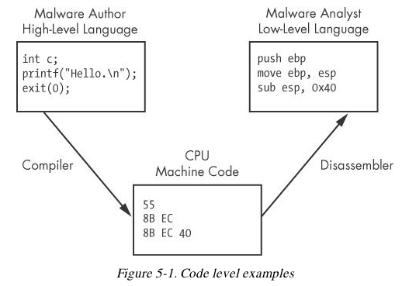

Slide 5
Six Levels of Abstraction
Hardware
Microcode
Machine code
Low-level languages
High-level languages
Interpreted languages

Slide 6
Hardware
Digital circuits
XOR, AND, OR, NOT gates
Cannot be easily manipulated by software
Notes:
Không thể dễ dàng thao tác bằng phần mềm

Slide 7
Microcode
Also called firmware
Only operates on specific hardware it was designed for
Not usually important for malware analysis

Slide 8
Machine code
Opcodes
Tell the processor to do something
Created when a program written in a high-level language is compiled

Slide 9
Low-level languages
Human-readable version of processor's instruction set
Assembly language
PUSH, POP, NOP, MOV, JMP ...
Disassembler generates assembly language
This is the highest level language that can be reliably recovered from malware when source code is unavailable
Notes:
Disassembler tạo hợp ngữ
Đây là ngôn ngữ cấp cao nhất có thể được khôi phục một cách đáng tin cậy khỏi phần mềm độc hại khi không có mã nguồn

Slide 10
High-level languages
Most programmers use these
C, C++, etc.
Converted to machine code by a compiler

Slide 11
Interpreted languages
Highest level
Java, C#, Perl, .NET, Python
Code is not compiled into machine code
It is translated into bytecode
An intermediate representation
Independent of hardware and OS
Bytecode executes in an interpreter, which translates bytecode into machine language on the fly at runtime
Ex: Java Virtual Machine
Notes:
Interpreted languages : Ngon ngu thong dich
Mã không được biên dịch thành mã máy
Nó được dịch sang bytecode
Một đại diện trung gian
Một đại diện trung gian Độc lập với phần cứng và hệ điều hành
Mã byte thực thi trong một trình thông dịch, giúp dịch mã byte sang ngôn ngữ máy một cách nhanh chóng khi chạy

Slide 12
Reverse Engineering

Slide 13
Disassembly
Malware on a disk is in binary form at the machine code level
Disassembly converts the binary form to assembly language
IDA Pro is the most popular disassembler

Slide 14
Assembly Language
Different versions for each type of processor
x86 – 32-bit Intel (most common)
x64 – 64-bit Intel
SPARC, PowerPC, MIPS, ARM – others
Windows runs on x86 or x64
x64 machines can run x86 programs
Most malware is designed for x86

Slide 15
The x86 Architecture

Slide 16
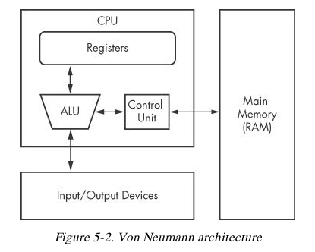
CPU (Central Processing Unit) executes code
RAM stores all data and code
I/O system interfaces with hard disk, keyboard, monitor, etc.

Slide 17
CPU Components
Control unit
Fetches instructions from RAM using a register named the instruction pointer
Registers
Data storage within the CPU
Faster than RAM
ALU (Arithmetic Logic Unit)
Executes an instruction and places results in registers or RAM

Slide 18
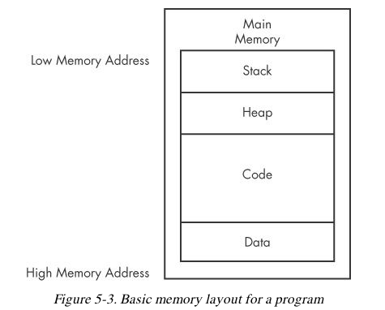
Main Memory (RAM)

Slide 19
Data
Values placed in RAM when a program loads
These values are static
They cannot change while the program is running
They are also global
Available to any part of the program

Slide 20
Code
Instructions for the CPU
Controls what the program does

Slide 21
Heap
Dynamic memory
Changes frequently during program execution
Program allocates new values, and frees them when they are no longer needed

Slide 22
Stack
Local variables and parameters for functions
Helps programs flow

Slide 23
Instructions
Mnemonic followed by operands
mov ecx 0x42
Move into Extended C register the value 42 (hex)
mov ecx is 0xB9 in hexadecimal
The value 42 is 0x4200000000
In binary this instruction is
0xB942000000

Slide 24
Endianness
Big-Endian
Most significant byte first
0x42 as a 64-bit value would be 0x00000042
Little-Endian
Least significant byte first
0x42 as a 64-bit value would be 0x42000000
Network data uses big-endian
x86 programs use little-endian

Slide 25
IP Addresses
127.0.0.1, or in hex, 7F 00 00 01
Sent over the network as 0x7F000001
Stored in RAM as 0x0100007F

Slide 26
Operands
Immediate
Fixed values like –x42
Register
eax, ebx, ecx, and so on
Memory address
Denoted with brackets, like [eax]

Slide 27
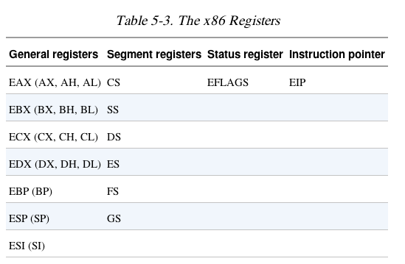
Registers

Slide 28
Registers
General registers
Used by the CPU during execution
Segment registers
Used to track sections of memory
Status flags
Used to make decisions
Instruction pointer
Address of next instruction to execute

Slide 29
Size of Registers
General registers are all 32 bits in size
Can be referenced as either 32bits (edx) or 16 bits (dx)
Four registers (eax, ebx, ecx, edx) can also be referenced as 8-bit values
AL is lowest 8 bits
AH is higher 8 bits

Slide 30
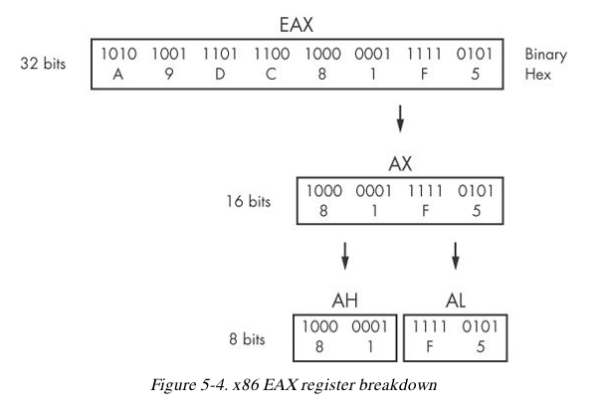

Slide 31
General Registers
Typically store data or memory addresses
Normally interchangeable
Some instructions reference specific registers
Multiplication and division use EAX and EDX
Conventions
Compilers use registers in consistent ways
EAX contains the return value for function calls

Slide 32
Flags
EFLAGS is a status register
32 bits in size
Each bit is a flag
SET (1) or Cleared (0)

Slide 33
Important Flags
ZF Zero flag
Set when the result of an operation is zero
CF Carry flag
Set when result is too large or small for destination
SF Sign Flag
Set when result is negative, or when most significant bit is set after arithmetic
TF Trap Flag
Used for debugging—if set, processor executes only one instruction at a time

Slide 34
EIP (Extended Instruction Pointer)
Contains the memory address of the next instruction to be executed
If EIP contains wrong data, the CPU will fetch non-legitimate instructions and crash
Buffer overflows target EIP

Slide 35
Simple Instructions

Slide 36
Simple Instructions
mov destination, source
Moves data from one location to another
We use Intel format throughout the book, with destination first
Remember indirect addressing
[ebx] means the memory location pointed to by EBX

Slide 37
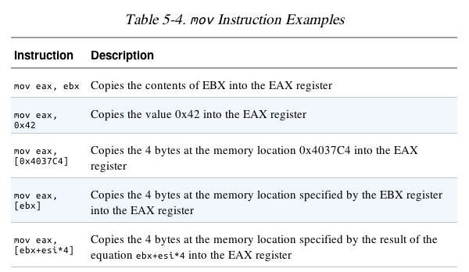

Slide 38
lea (Load Effective Address)
lea destination, source
lea eax, [ebx+8]
Puts ebx + 8 into eax
Compare
mov eax, [ebx+8]
Moves the data at location ebx+8 into eax

Slide 39
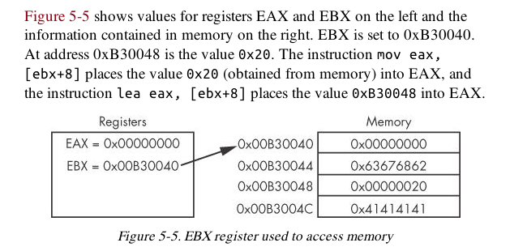

Slide 40
Arithmetic
sub Subtracts
add Adds
inc Increments
dec Decrements
mul Multiplies
div Divides

Slide 41
NOP
Does nothing
0x90
Commonly used as a NOP Sled
Allows attackers to run code even if they are imprecise about jumping to it

Slide 42
The Stack
Memory for functions, local variables, and flow control
Last in, First out
ESP (Extended Stack Pointer) – top of stack
EBP (Extended Base Pointer) – bottom of stack
PUSH puts data on the stack
POP takes data off the stack

Slide 43
Other Stack Instructions
All used with functions
Call
Leave
Enter
Ret

Slide 44
Function Calls
Small programs that do one thing and return, like printf()
Prologue
Instructions at the start of a function that prepare stack and registers for the function to use
Epilogue
Instructions at the end of a end of a function that restore the stack and registers to their state before the function was called

Slide 45
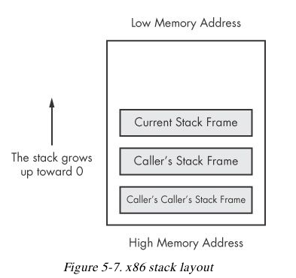

Slide 46
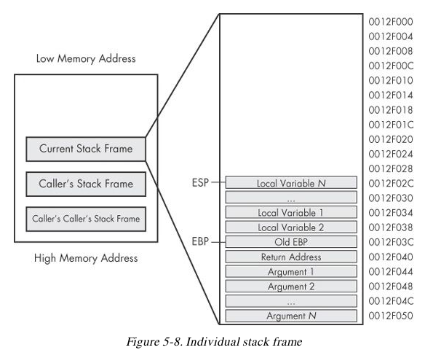

Slide 47
Conditionals
test
Compares two values the way AND does, but does not alter them
test eax, eax
Sets Zero Flag if eax is zero
cmp eax, ebx
Sets Zero Flag if the arguments are equal

Slide 48
Branching
jz loc
Jump to loc if the Zero Flag is set
jnz loc
Jump to loc if the Zero Flag is cleared

Slide 49
C Main Method
Every C program has a main() function
int main(int argc, char** argv)
argc contains the number of arguments on the command line
argv is a pointer to an array of names containing the arguments

Slide 50
Example
cp foo bar
argc = 3
argv[0] = cp
argv[1] = foo
argv[2] = bar

